Slide 1
Networking with LOGO! 0BA7
+ LOGO! To LOGO! Data exchange
+ Communication configuration
+ VM-Mapping
+ Simulation in LOGO! Soft Comfort V7

Slide 2

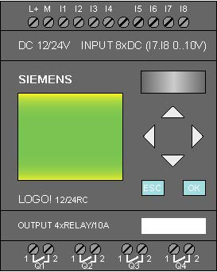
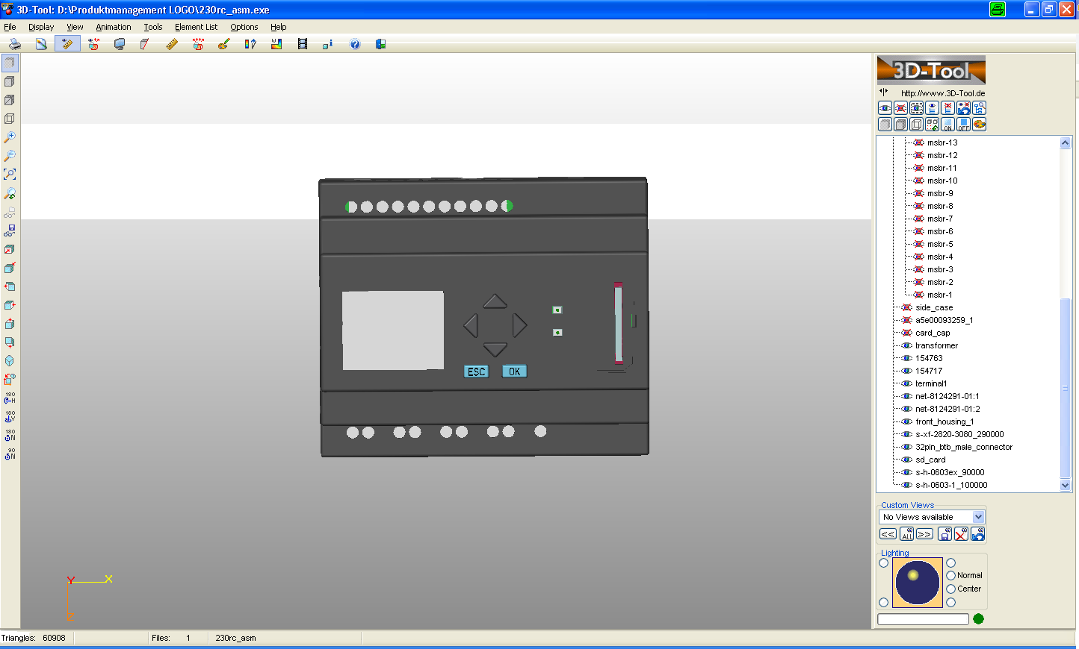

LOGO! 0BA7 to LOGO! 0BA7 Networking
PG/PC
LOGO! 0BA7
LOGO! 0BA7
E
E
E
E
LOGO! 0BA7
8 + 1 connections supported (PG/PC)
8 Channels can be configured as Server or
Client
At the same time data exchange from/to
+ LOGO! Slave (Remote IO)
+ LOGO! Master
+ Siemens HMI
+ SIMATIC Controller
+ PG/PC via OPC
is possible

Slide 3
LOGO! 0BA7 to LOGO! 0BA7 Networking
Data exchange
E
E
E
E
LOGO! 0BA7
executes a program
communication must be
configured
data for exchange have to be
configured
LOGO! 0BA7
executes a program
communication must be
configured
data for exchange have to be
configured

Slide 4
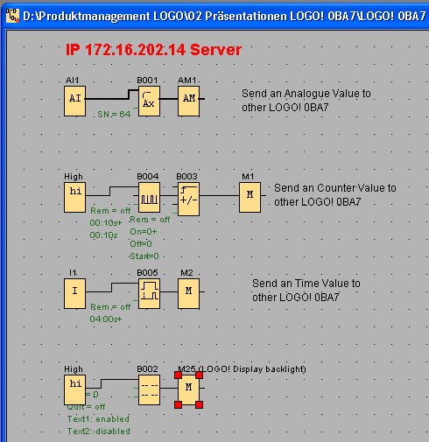
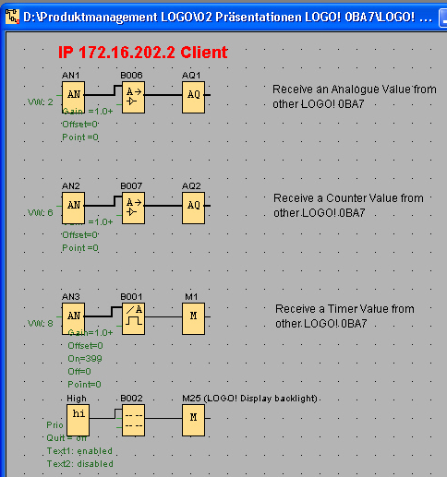
LOGO! 0BA7 to LOGO! 0BA7 Networking
Server: IP = 172.16.202.x
Client: IP = 172.16.202.x
Create the following two programs
Change LSC V7 to “Internal window” (Tools; options; document view)
Server: IP = 172.16.202.x
Client: IP = 172.16.202.x

Slide 5
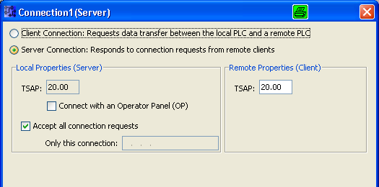
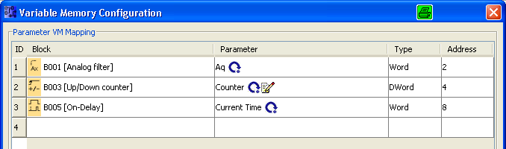
LOGO! 0BA7 to LOGO! 0BA7 Networking
Server: IP = 172.16.202.x
Client: IP = 172.16.202.x
Configure a Server connection with the following TSAPs
Fill the VM-Mapping table with the data
Server: IP = 172.16.202.x
1
TSAP: 20.00 .. 27.00
2
TSAP:
Transport Service Access Point
1
Connection: Tools; Ethernet connection.
2
VM-Mapping table: Tools; Parameter VM-Mapping

Slide 6
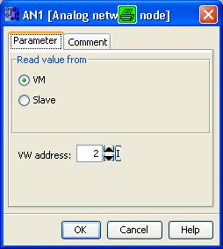
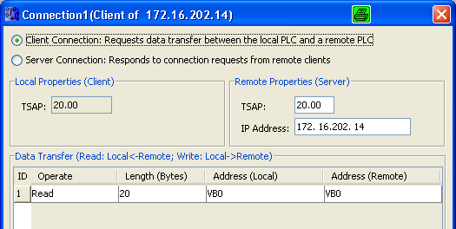



LOGO! 0BA7 to LOGO! 0BA7 Networking
Server: IP = 172.16.202.x
Client: IP = 172.16.202.x
Create a Client connection
Fill the VM-Mapping table if necessary
Client: IP = 172.16.202.x
READ 20 Bytes, starting from remote VB0, store it local at VB0
No additional “mapping” necessary
Use second part of DW of counter
If a SIMATIC Controller is Server, then use DB1.DBWx
Notes:
Client configuration:
Up to 32 operations are possible.
Max. Length is 212 Bytes.
Address Local VB0 … VB 850 is possible
A 212 Bytes transfer requires ~100ms
So max. is:
8 Controller, 32 operations, each 212 bytes = 54.272Byts
So we recommend only to exchange data to one SIMATIC Controller.

Slide 7
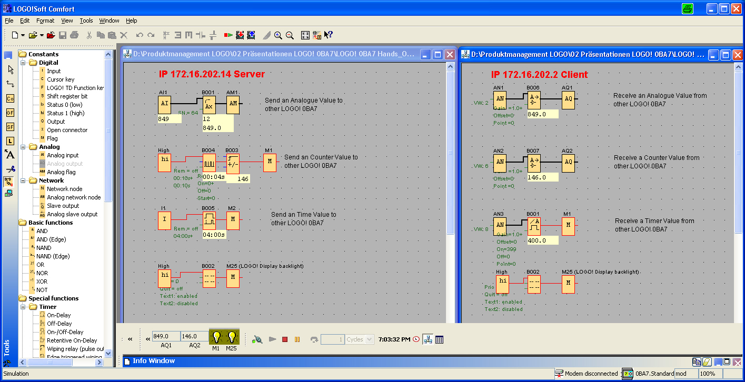
Simulate Networking between LOGO! 0BA7
Change LSC V7 to “Internal window” (Tools; options; document view), so you can see both programs at the same time
Server: IP = 172.16.202.x
Client: IP = 172.16.202.x
1
Now enable each window and start the simulation.
1
2
2
Start the network simulation of both programs and check the displayed values

Slide 8
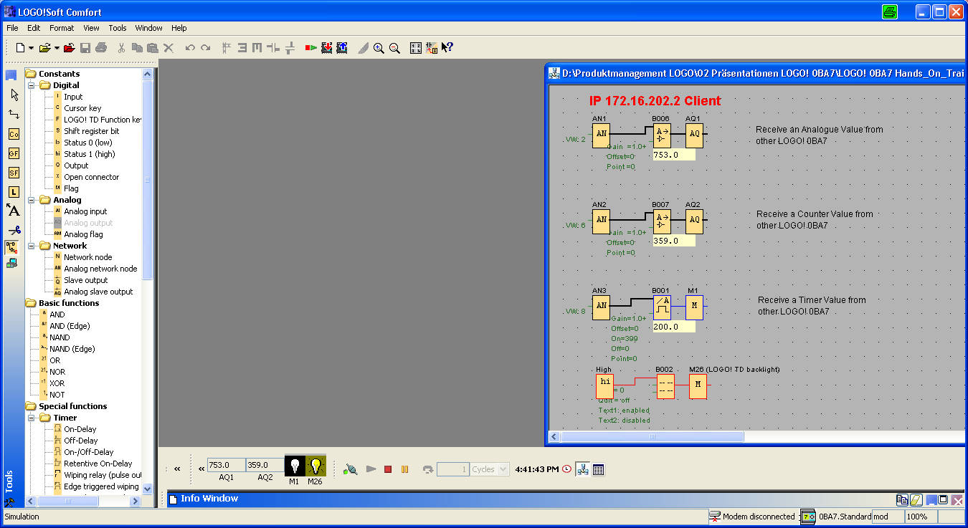
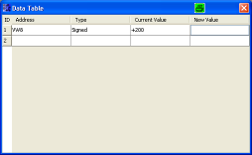
Simulation of Network data with
LOGO! Soft Comfort V7
Change LSC V7 to “Internal window” (Tools; options; document view), so you can see both programs at the same time.
Client: IP = 172.16.202.x
1
4
Start the simulation.
New Value
2
1
Start the network simulation
3
3
Start the Data table and enter variable
2
4
Enter new value

Slide 9
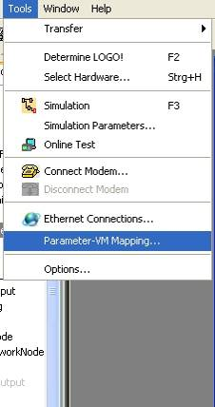
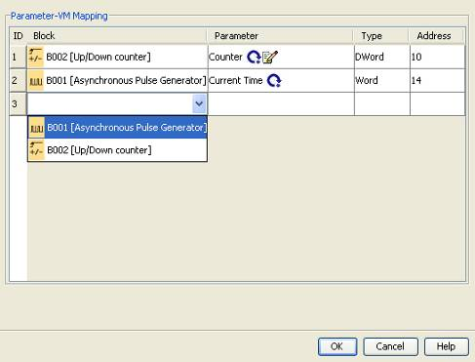
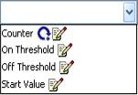
LOGO! 0BA7 to LOGO! 0BA7 Networking
VM-Mapping
FB selection
Parameter
selection
Location
Max. 32 allowed
Number of data
Data type
automatically

Slide 10
Networking wiht LOGO! 0BA7 V1
Thank you for your attention!
H. Schindler
I IA AS FA PS4
Phone: ++49 (0)911 / 895 - 3665
E-Mail: Helmut.schindler@siemens.com

